Slide 1
ejukebox
Music done your way.

Slide 2
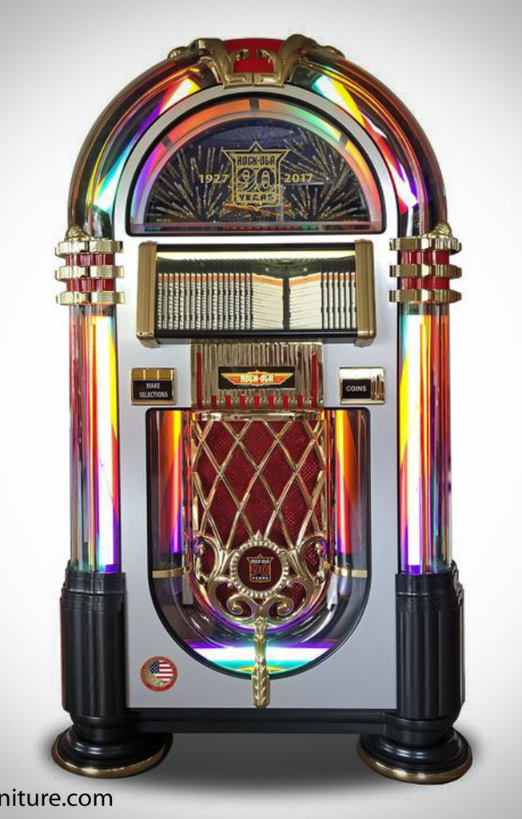
Whats a JukeBox ?
partially automated music-playing device
usually a coin-operated machine
play a patron's selection from self-contained media
In 1918, Hobart C. Niblack patented an apparatus that automatically changed records
leading to one of the first selective jukeboxes being introduced in 1927
Jukeboxes were most popular from the 1940s through the mid-1960s

Slide 3
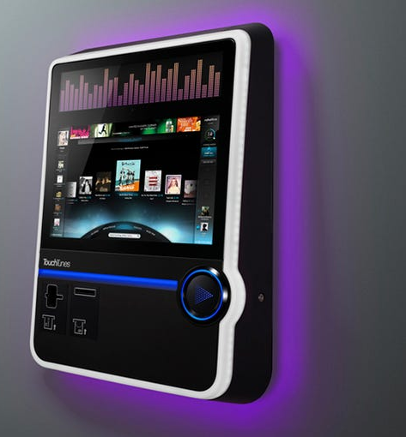
eJukeBox Goals & Vision:
Digital, App based JukeBox Experience
Smart Pay / Vote oriented songs system
1 Host (a bar, coffee house), Many Clients
Crowd Control music.
Songs being picked by votes of the crowd
Music have never been so fun

Slide 4
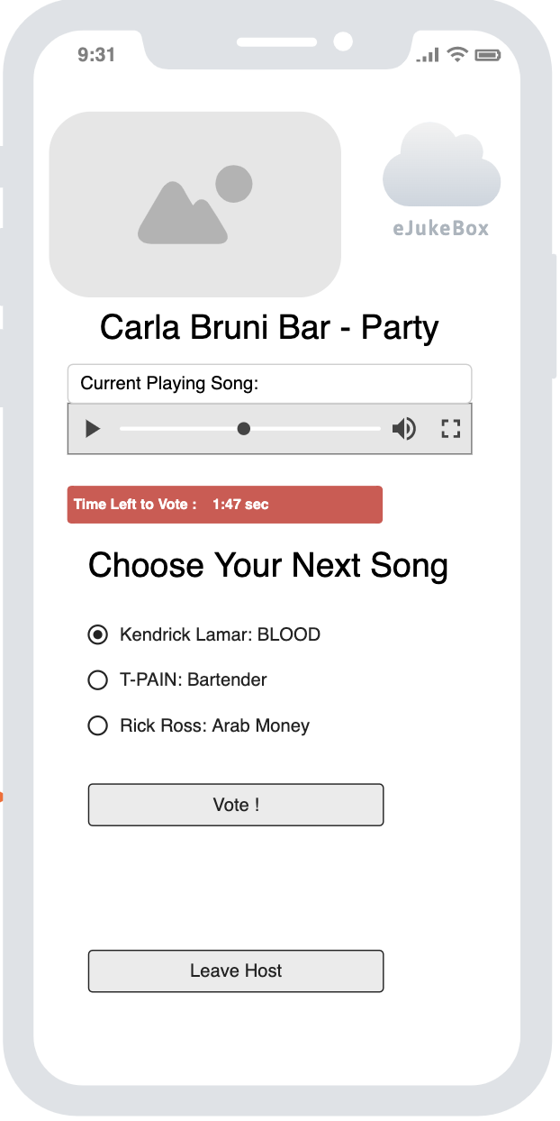
Abstract Vision
Example User Interface

Slide 5
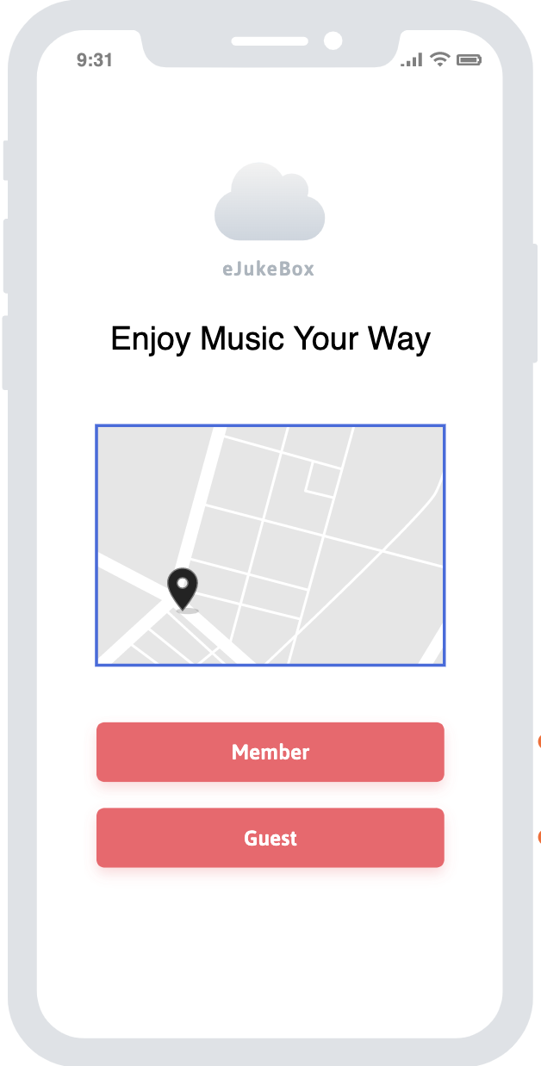
But first, Authentication.
Light, Multi optional and friendly Welcome page.
Via Location.
Via Member subscription.
Via Guest Mode.

Slide 6
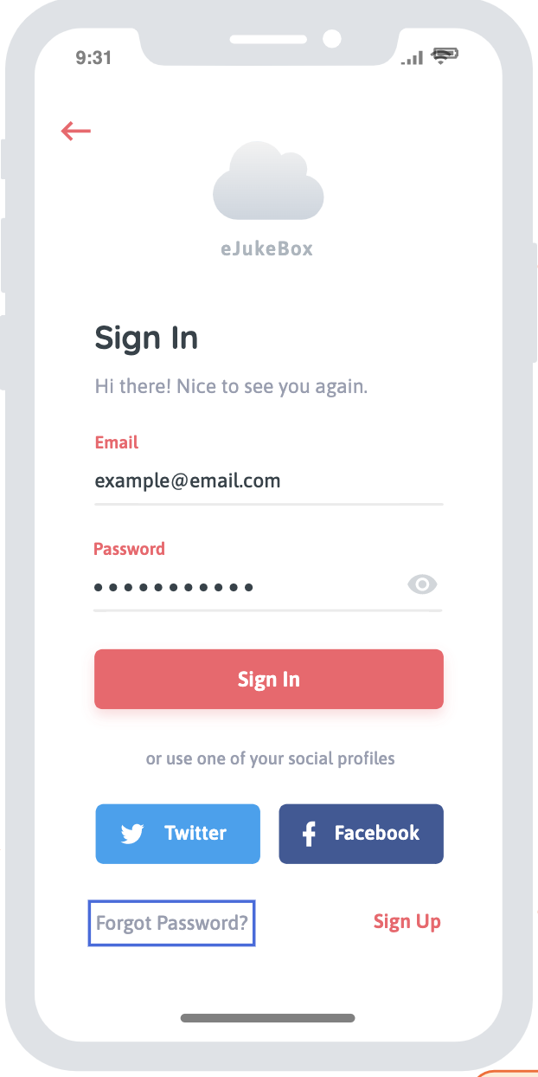
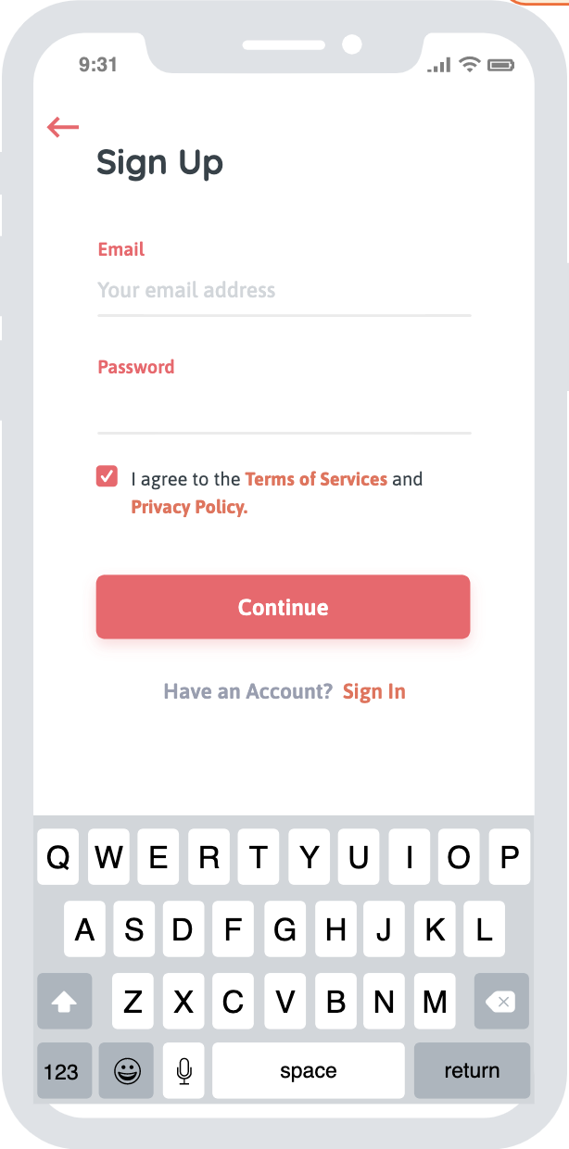
Via Member Subscription
Registration
Third Party Vendors
Sign up

Slide 7
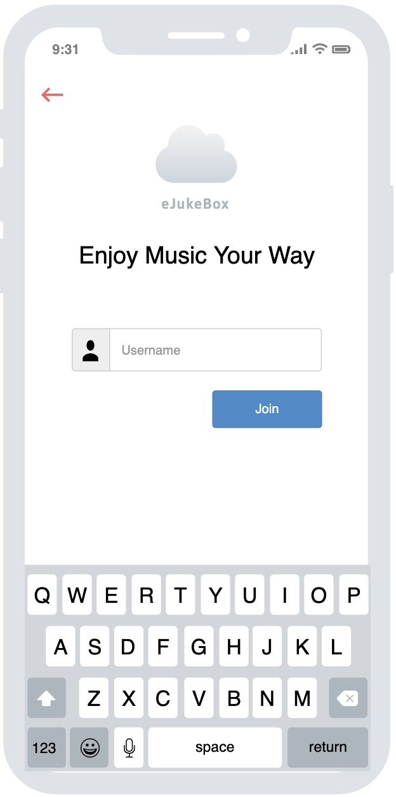
Guest Mode
Just Enter your nickname.

Slide 8
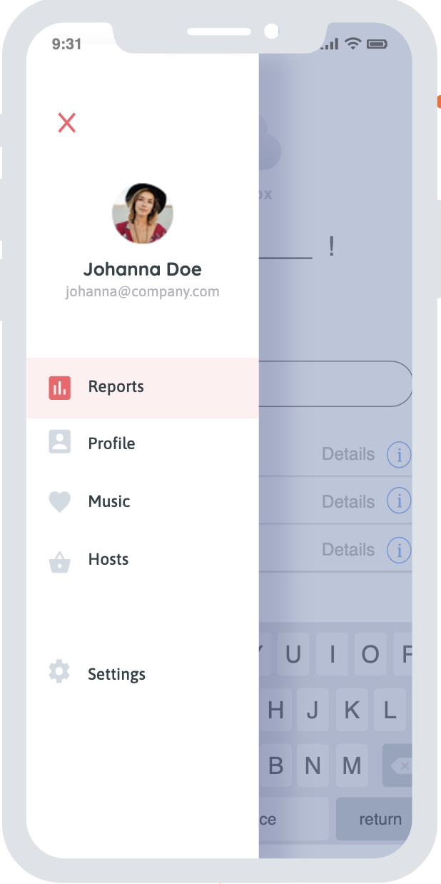
Guest Mode ? So why should I sign in ?
Users Enjoy personal extra features
Users gets preferred attention
Hosts gets information about users that will help them configure music to the user’s taste.

Slide 9
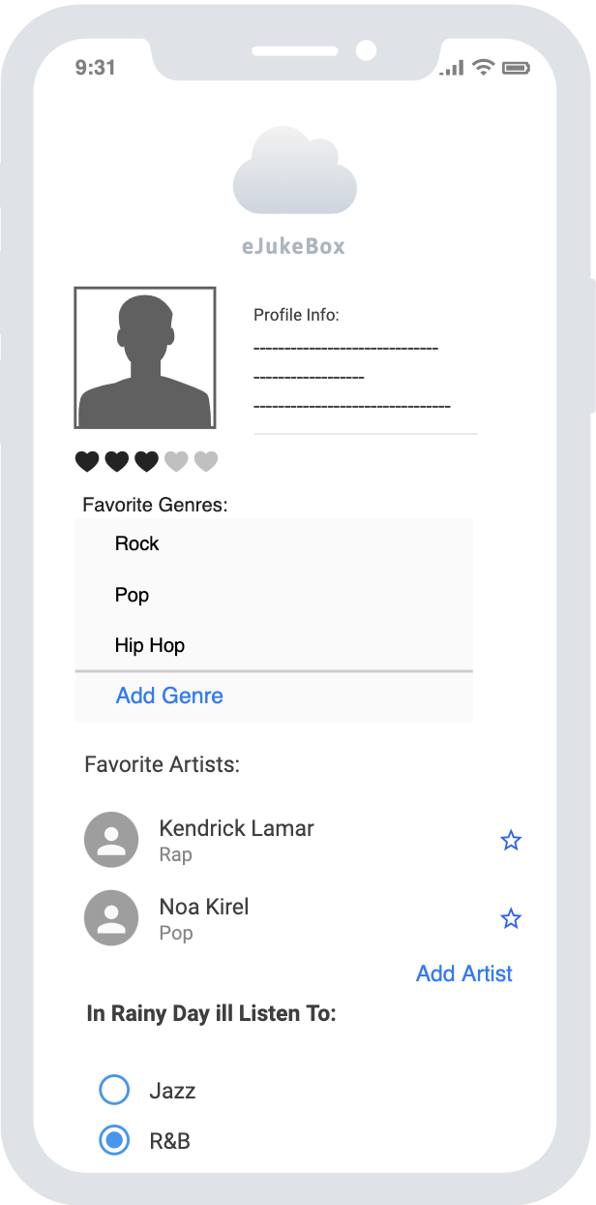
Users Enjoy more. Users perks are:
Adding / Removing personal data
Genre's personalization
Favorite Artists
More Data collection about you flavor in music
That a way the host could manipulate the options to fit the crowd’s taste.

Slide 10
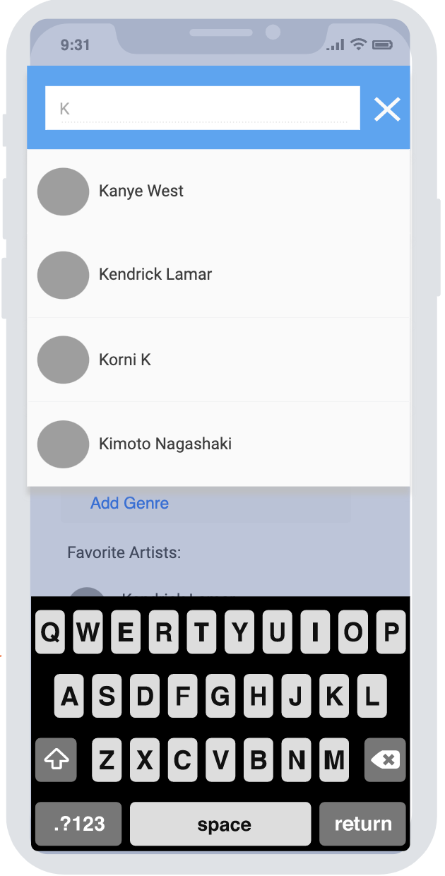
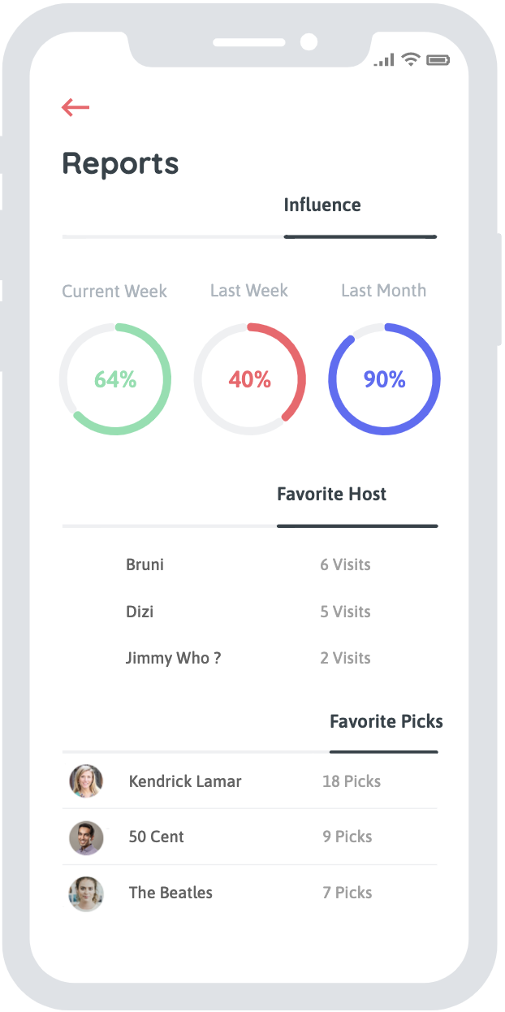
ALSO
Adding Artists
History Reports
And More..

Slide 11
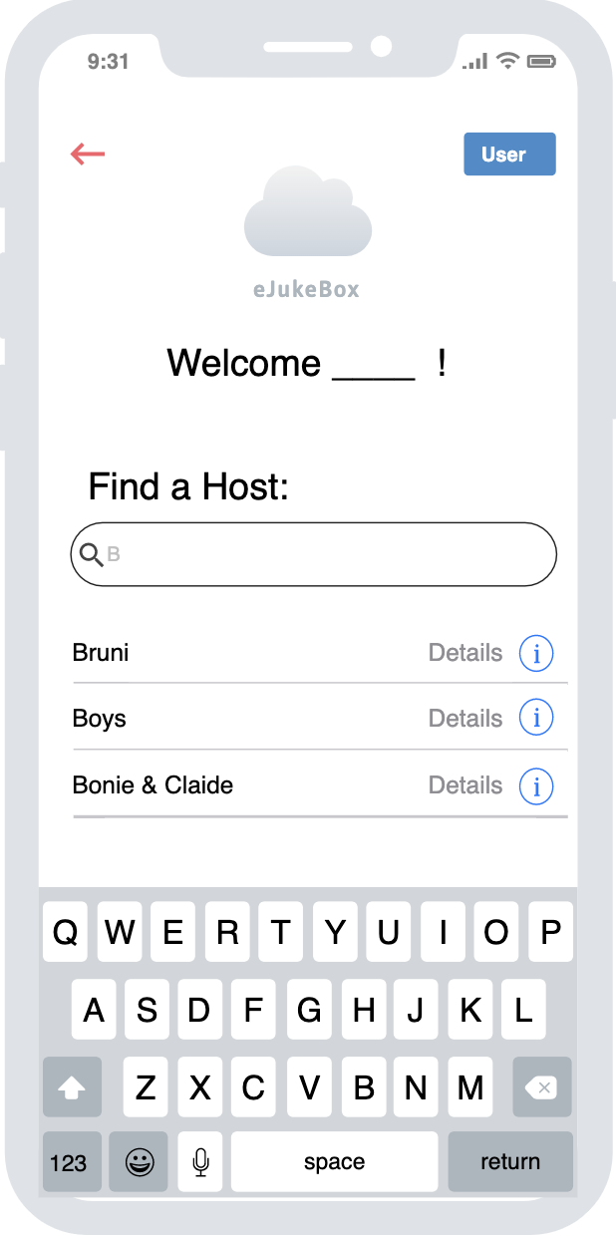
OK. You been identified. Now Host Conection.
First. Either you a subscribed member or a guest member, you need to find the host.
The host is the Owner of the virtual JukeBox aka eJukeBox.
The interface for manually host search, is friendly and simple.
The host would physically hand the clients information about his host page on the app.
Starting to type will bring relevant results.

Slide 12
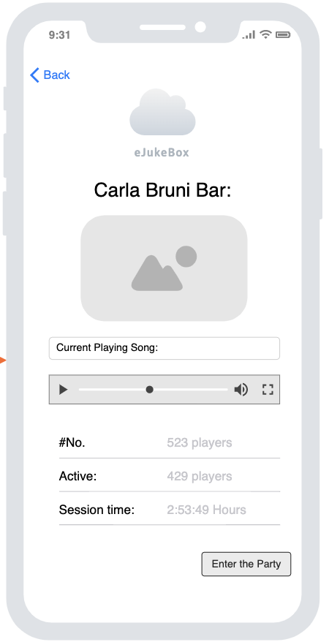
You Found your host. Host Page Includes:
Current Song being played
Users joined so far
Active users
Session Time
Now you just need to ‘Enter the Party’

Slide 13
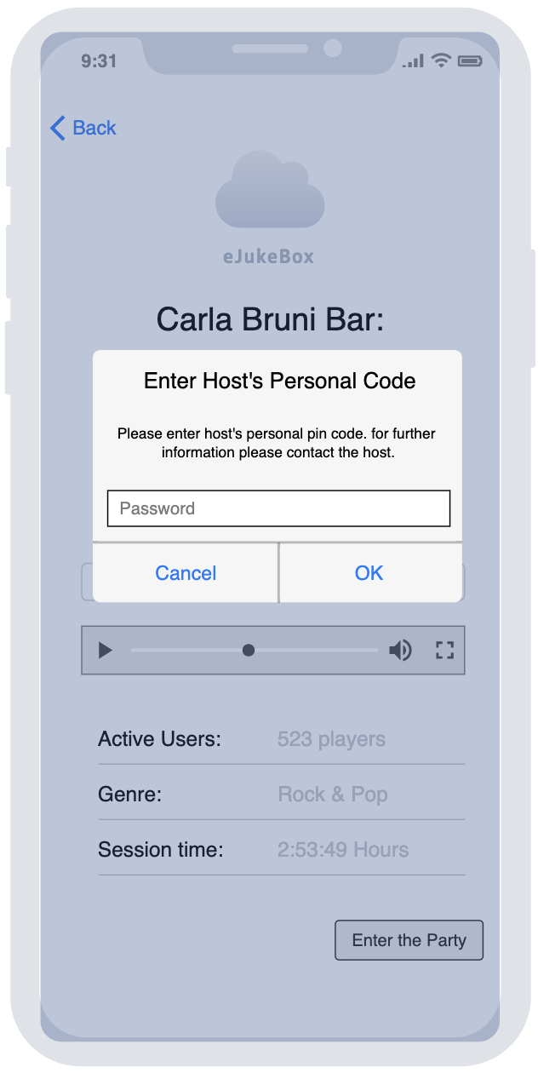
2-Way Authentication
To prevent distant log in

Slide 14
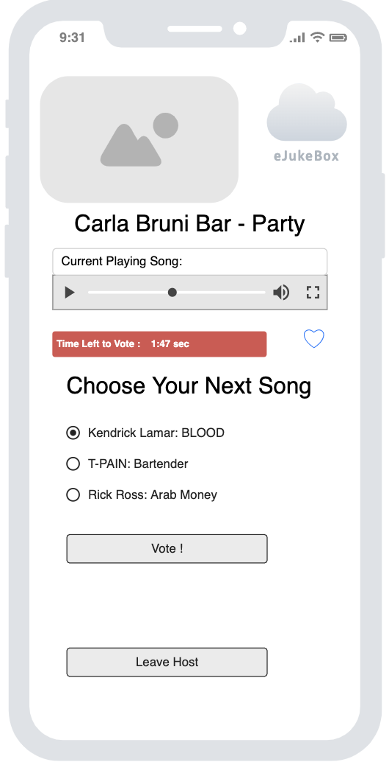
Congratiolation ! You entered the party
See what’s being played right now (therefore no need for music recognition apps).
See the interval for music selection.
Vote for the next song you want to be played for everyone.
Or leave and join another host.
Users could “Like and Save” favorites songs.
Like

Slide 15
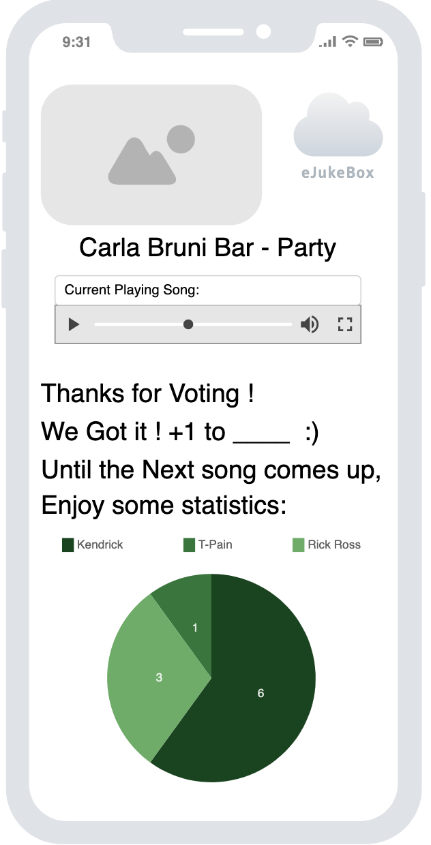
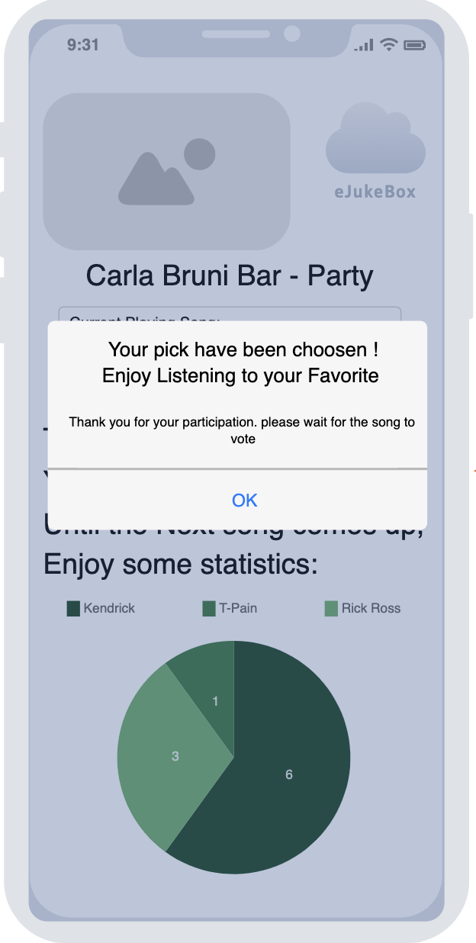
After Voting
See vote statistics and thank you confirmation
When its time for next song selection you will be notified and transfer back

Slide 16

So That’s It. The whole user experience. many more features to come

